Slide 1




Intelligent Academic Management & AI-Powered Learning Support
AI SMART COLLEGE ASSISTANT

Slide 2
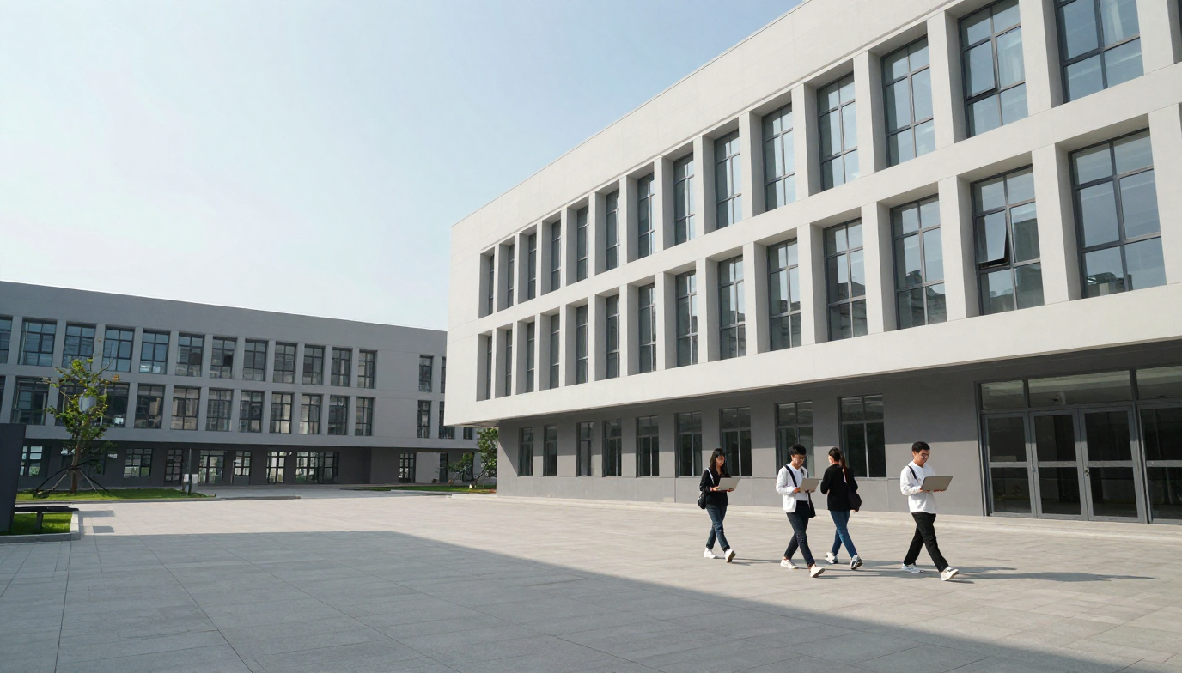
Introduction
What is AI Smart College Assistant?
AI Smart College Assistant is an all-in-one intelligent academic platform.
Helps students manage studies, deadlines, and placement prep.
Supports faculty with assignments, attendance, and feedback tools.
Gives admins a centralized dashboard for academic management.
One smart system — connecting students, faculty, and admins seamlessly.

Slide 3
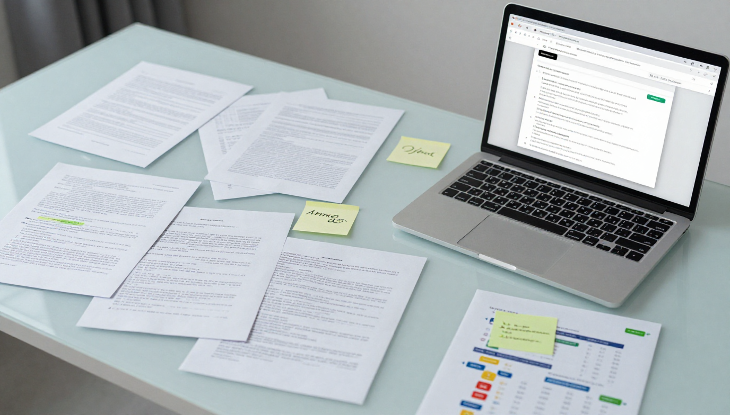

Problem Statement
The main problem is that college information and resources are scattered across different platforms, making it difficult for students to access information, meet deadlines, prepare effectively, and receive personalized guidance
  Scattered Academic Information
  Missed Deadlines & Updates
  Fragmented Study Resources
  Limited Personalized Guidance
Students need one intelligent platform that brings academic information, resources, guidance, and support together

Slide 4


Objectives
Our Main Objectives
📚 Centralize academic resources
🤖 Provide document-based AI answers
📊 Automate attendance and assignment tracking
🎯 Improve placement preparation
📝 Generate dynamic quizzes
🎤 Provide AI mock interviews
🔔 Send timely notifications
👨‍🏫 Simplify faculty and admin management

Slide 5

Existing System
  Search information manually
  Depend on multiple communication channels
  Manually track assignments and attendance
  Generic preparation resources
  Manual attendance management
  Separate distribution of notes and notices
Before: Students struggle with fragmented tools → After: One smart, unified platform

Slide 6

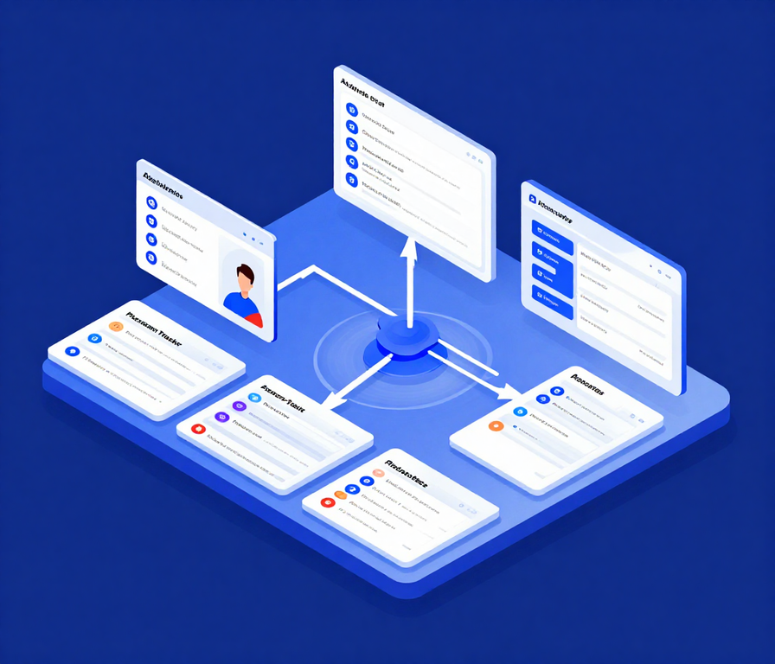
Proposed System
One platform to manage academics, learning, and placement preparation intelligently
Academic Dashboard
Centralized view of academic activities and student progress.
Attendance & Assignment Tracking
Monitor attendance, assignments, and academic progress in one place.
Dynamic Quiz Generator
Smart Notifications
Stay updated with assignments, deadlines, and important academic alerts.
Personalized Learning
AI Placement Preparation
Practice mock interviews and prepare with AI-driven guidance.
Smart Timetable

Slide 7

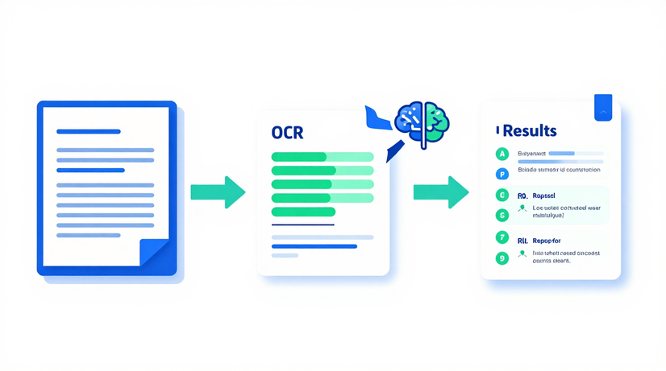
AI Exam Paper Scanning & Checking

Slide 8

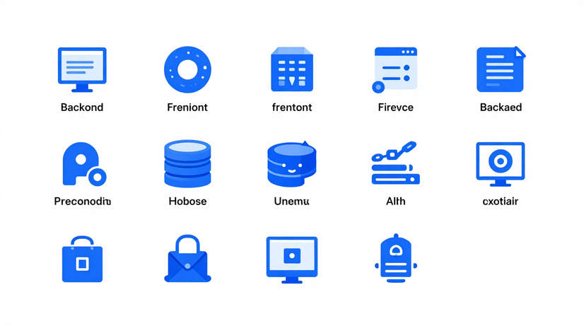
Technology Stack

Slide 9
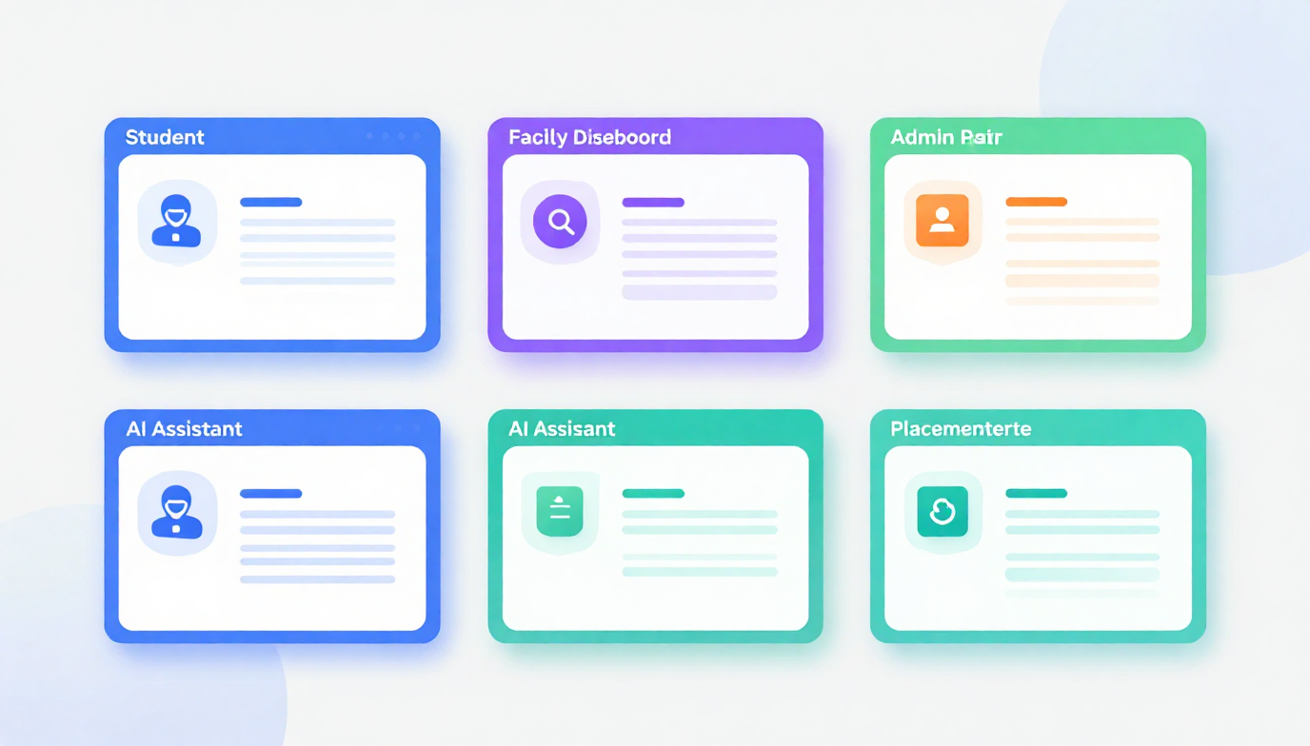
Key Modules
🎓 Student Module – Timetable, assignments, attendance & AI Q&A
👨‍🏫 Faculty Module – Upload materials, mark attendance, give feedback
🛡️ Admin Module – Manage users, notices & academic data
🤖 AI / RAG Module – Document-based answers using Gemini + LangChain4j
💼 Placement Suite – Resume tips, mock tests & company prep resources
Each module works together on one unified platform for a seamless experience.

Slide 10

Future Scope
📱 Mobile App – Access everything on the go
🎙️ Voice Assistant – Ask queries using voice commands
✍️ Handwritten OCR – Scan handwritten answer sheets
📷 Facial Attendance – Auto mark attendance via face recognition
🌐 Multilingual Support – Use the system in your language
📊 Advanced Analytics – Track progress with smart dashboards
🤖 AI Exam Checking – Fully automated answer evaluation
Planned enhancements to make the system smarter, more accessible, and fully automated.

Slide 11


Conclusion

Slide 12

Thank You! Questions & Answers

